Slide 1

Loan Management System
SQL Analysis & Risk Assessment Framework
A comprehensive SQL-driven approach to evaluating loan applications, assessing risk profiles, and optimizing approval decisions through data-driven insights.

Slide 2

Dataset Overview
Core Data Elements
Our loan applications dataset captures critical financial and demographic information for each applicant:
Personal identifiers (name, city)
Financial metrics (income, loan amount)
Credit assessment (credit score, points)
Employment history (years employed)
Approval status (loan_approved)
This structured dataset enables sophisticated risk analysis and
pattern detection across multiple dimensions of borrower
creditworthiness.

Slide 3




Problem Statements
Our analysis addresses ten critical business questions that drive loan decisioning:
Loan-to-Income Ratio
Approval Patterns
Identify high-risk applicants exceeding 30% debt burden
Compare credit profiles across approval statuses
Risk Anomalies
Applicant Ranking
Flag counterintuitive income-credit combinations
Score and prioritize candidates systematically

Slide 4
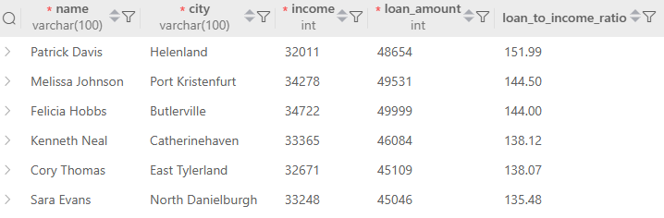
-- Q1: Find all applicants whose loan amount is greater than 30% of their annual income
This query identifies applicants whose loan amounts exceed 30% of their annual income—a key indicator of potential repayment stress.
SELECT name, city, income, loan_amount,
ROUND((loan_amount / income * 100), 2) AS loan_to_income_ratio
FROM loan_applications
WHERE loan_amount > (income * 0.30)
ORDER BY loan_to_income_ratio DESC;

Slide 5
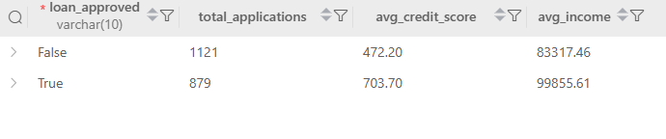
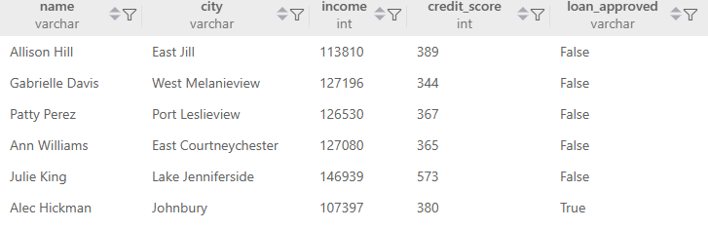
Q2 & Q3: Credit Profile Analysis
-- Q2: Calculate the average credit score for approved vs rejected loans
SELECT loan_approved,
COUNT(*) AS total_applications,
ROUND(AVG(credit_score), 2) AS avg_credit_score,
ROUND(AVG(income), 2) AS avg_income
FROM loan_applications
GROUP BY loan_approved;
-- Q3: Find applicants who have above-average income but below-average credit scores
SELECT name, city, income, credit_score, loan_approved
FROM loan_applications
WHERE income > (SELECT AVG(income) FROM loan_applications)
AND credit_score < (SELECT AVG(credit_score) FROM loan_applications);
These queries reveal approval patterns and identify high-income applicants with surprisingly low credit scores—potential fraud signals or unique circumstances requiring investigation.

Slide 6
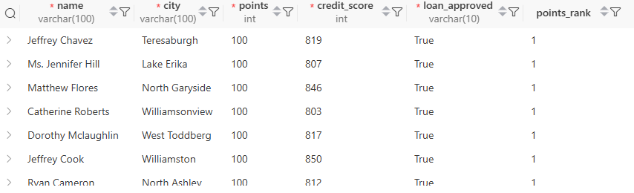
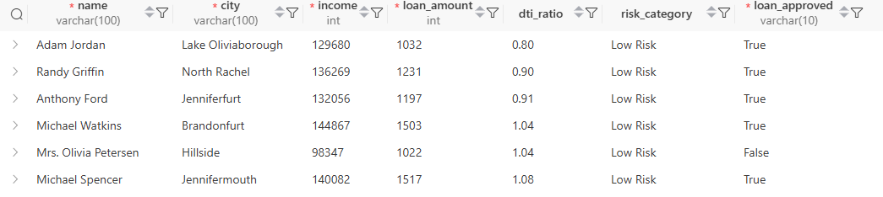
Q4 & Q5: Risk Categorization
-- Q4: Rank applicants by their points and show their loan approval status
SELECT name, city, points, credit_score, loan_approved,
RANK() OVER (ORDER BY points DESC) AS points_rank
FROM loan_applications
ORDER BY points DESC;
-- Q5: Calculate the debt-to-income ratio and categorize applicants into risk levels
-- (Low Risk: <25%, Medium Risk: 25-40%, High Risk: >40%)
SELECT name, city, income, loan_amount,
ROUND((loan_amount / income * 100), 2) AS dti_ratio,
CASE
WHEN (loan_amount / income * 100) < 25 THEN 'Low Risk'
WHEN (loan_amount / income * 100) BETWEEN 25 AND 40 THEN 'Medium Risk'
ELSE 'High Risk'
END AS risk_category,
loan_approved
FROM loan_applications
ORDER BY dti_ratio;

Slide 7
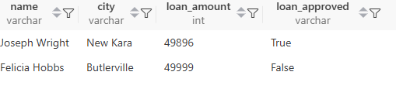
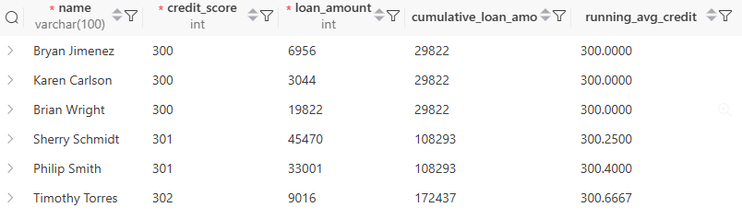
Q6 & Q7: Advanced Analytics
-- Q6: Find the applicant(s) with the highest loan amount in each approval status category
SELECT name, city, loan_amount, loan_approved
FROM loan_applications la1
WHERE loan_amount = (
SELECT MAX(loan_amount)
FROM loan_applications la2
WHERE la1.loan_approved = la2.loan_approved);
-- Q7: Calculate cumulative statistics for applicants ordered by credit score
SELECT name, credit_score, loan_amount,
SUM(loan_amount) OVER (ORDER BY credit_score) AS cumulative_loan_amount,
AVG(credit_score) OVER (ORDER BY credit_score ROWS BETWEEN UNBOUNDED PRECEDING AND CURRENT ROW) AS running_avg_credit
FROM loan_applications
ORDER BY credit_score;

Slide 8
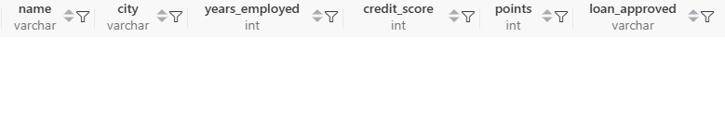
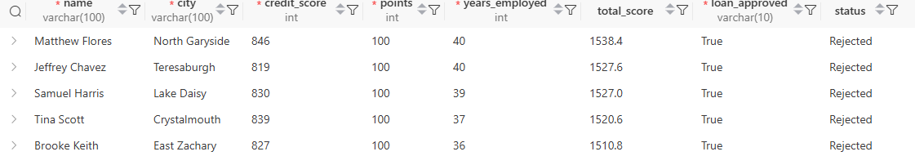
Q8 & Q9: Scoring System Analysis
-- Q8: Find applicants whose years of employment is above average
-- but still got rejected (loan_approved = 'FALSE')
SELECT name, city, years_employed, credit_score, points, loan_approved
FROM loan_applications
WHERE years_employed > (SELECT AVG(years_employed) FROM loan_applications)
AND loan_approved = 'FALSE'
ORDER BY years_employed DESC;
-- Q9: Create a scoring system: Calculate total_score = (credit_score * 0.4) + (points * 10) +
(years_employed * 5)
-- and compare it with loan approval status
SELECT name, city, credit_score, points, years_employed,
ROUND((credit_score * 0.4) + (points * 10) + (years_employed * 5), 2) AS total_score,
loan_approved,
CASE
WHEN loan_approved = 'TRUE' THEN 'Approved'
ELSE 'Rejected'
END AS status
FROM loan_applications
ORDER BY total_score DESC;

Slide 9
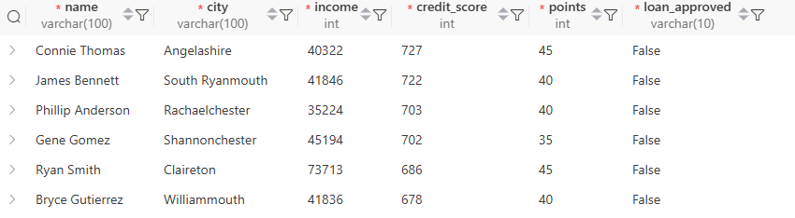
-- Q10 : Find all applicants who have either:
-- (high credit score > 600 AND low points < 50) OR (low income < 60000 AND approved)
SELECT name, city, income, credit_score, points, loan_approved
FROM loan_applications
WHERE (credit_score > 600 AND points < 50)
OR (income < 60000 AND loan_approved = 'TRUE')
ORDER BY credit_score DESC;

Slide 10

Strategic Recommendations
01
Refine Scoring Weights
Adjust the composite scoring formula based on approval outcomes to improve predictive accuracy. Test different weight distributions for credit score, points, and employment history.
02
Implement Risk Tiers
Automate approvals for low-risk applicants (DTI <25%, credit >650) while routing medium and high-risk cases to underwriters for manual review.
03
Investigate Anomalies
Create alerts for high-income/low-credit combinations and experienced applicants with rejections. These edge cases may reveal process gaps or fraud patterns.
04
Monitor Approval Thresholds
Regularly analyze approved vs. rejected cohorts to ensure credit score and income averages align with risk appetite and portfolio performance goals.

Slide 11
Thank You

